Slide 1
We form managers. Successfully

Slide 2
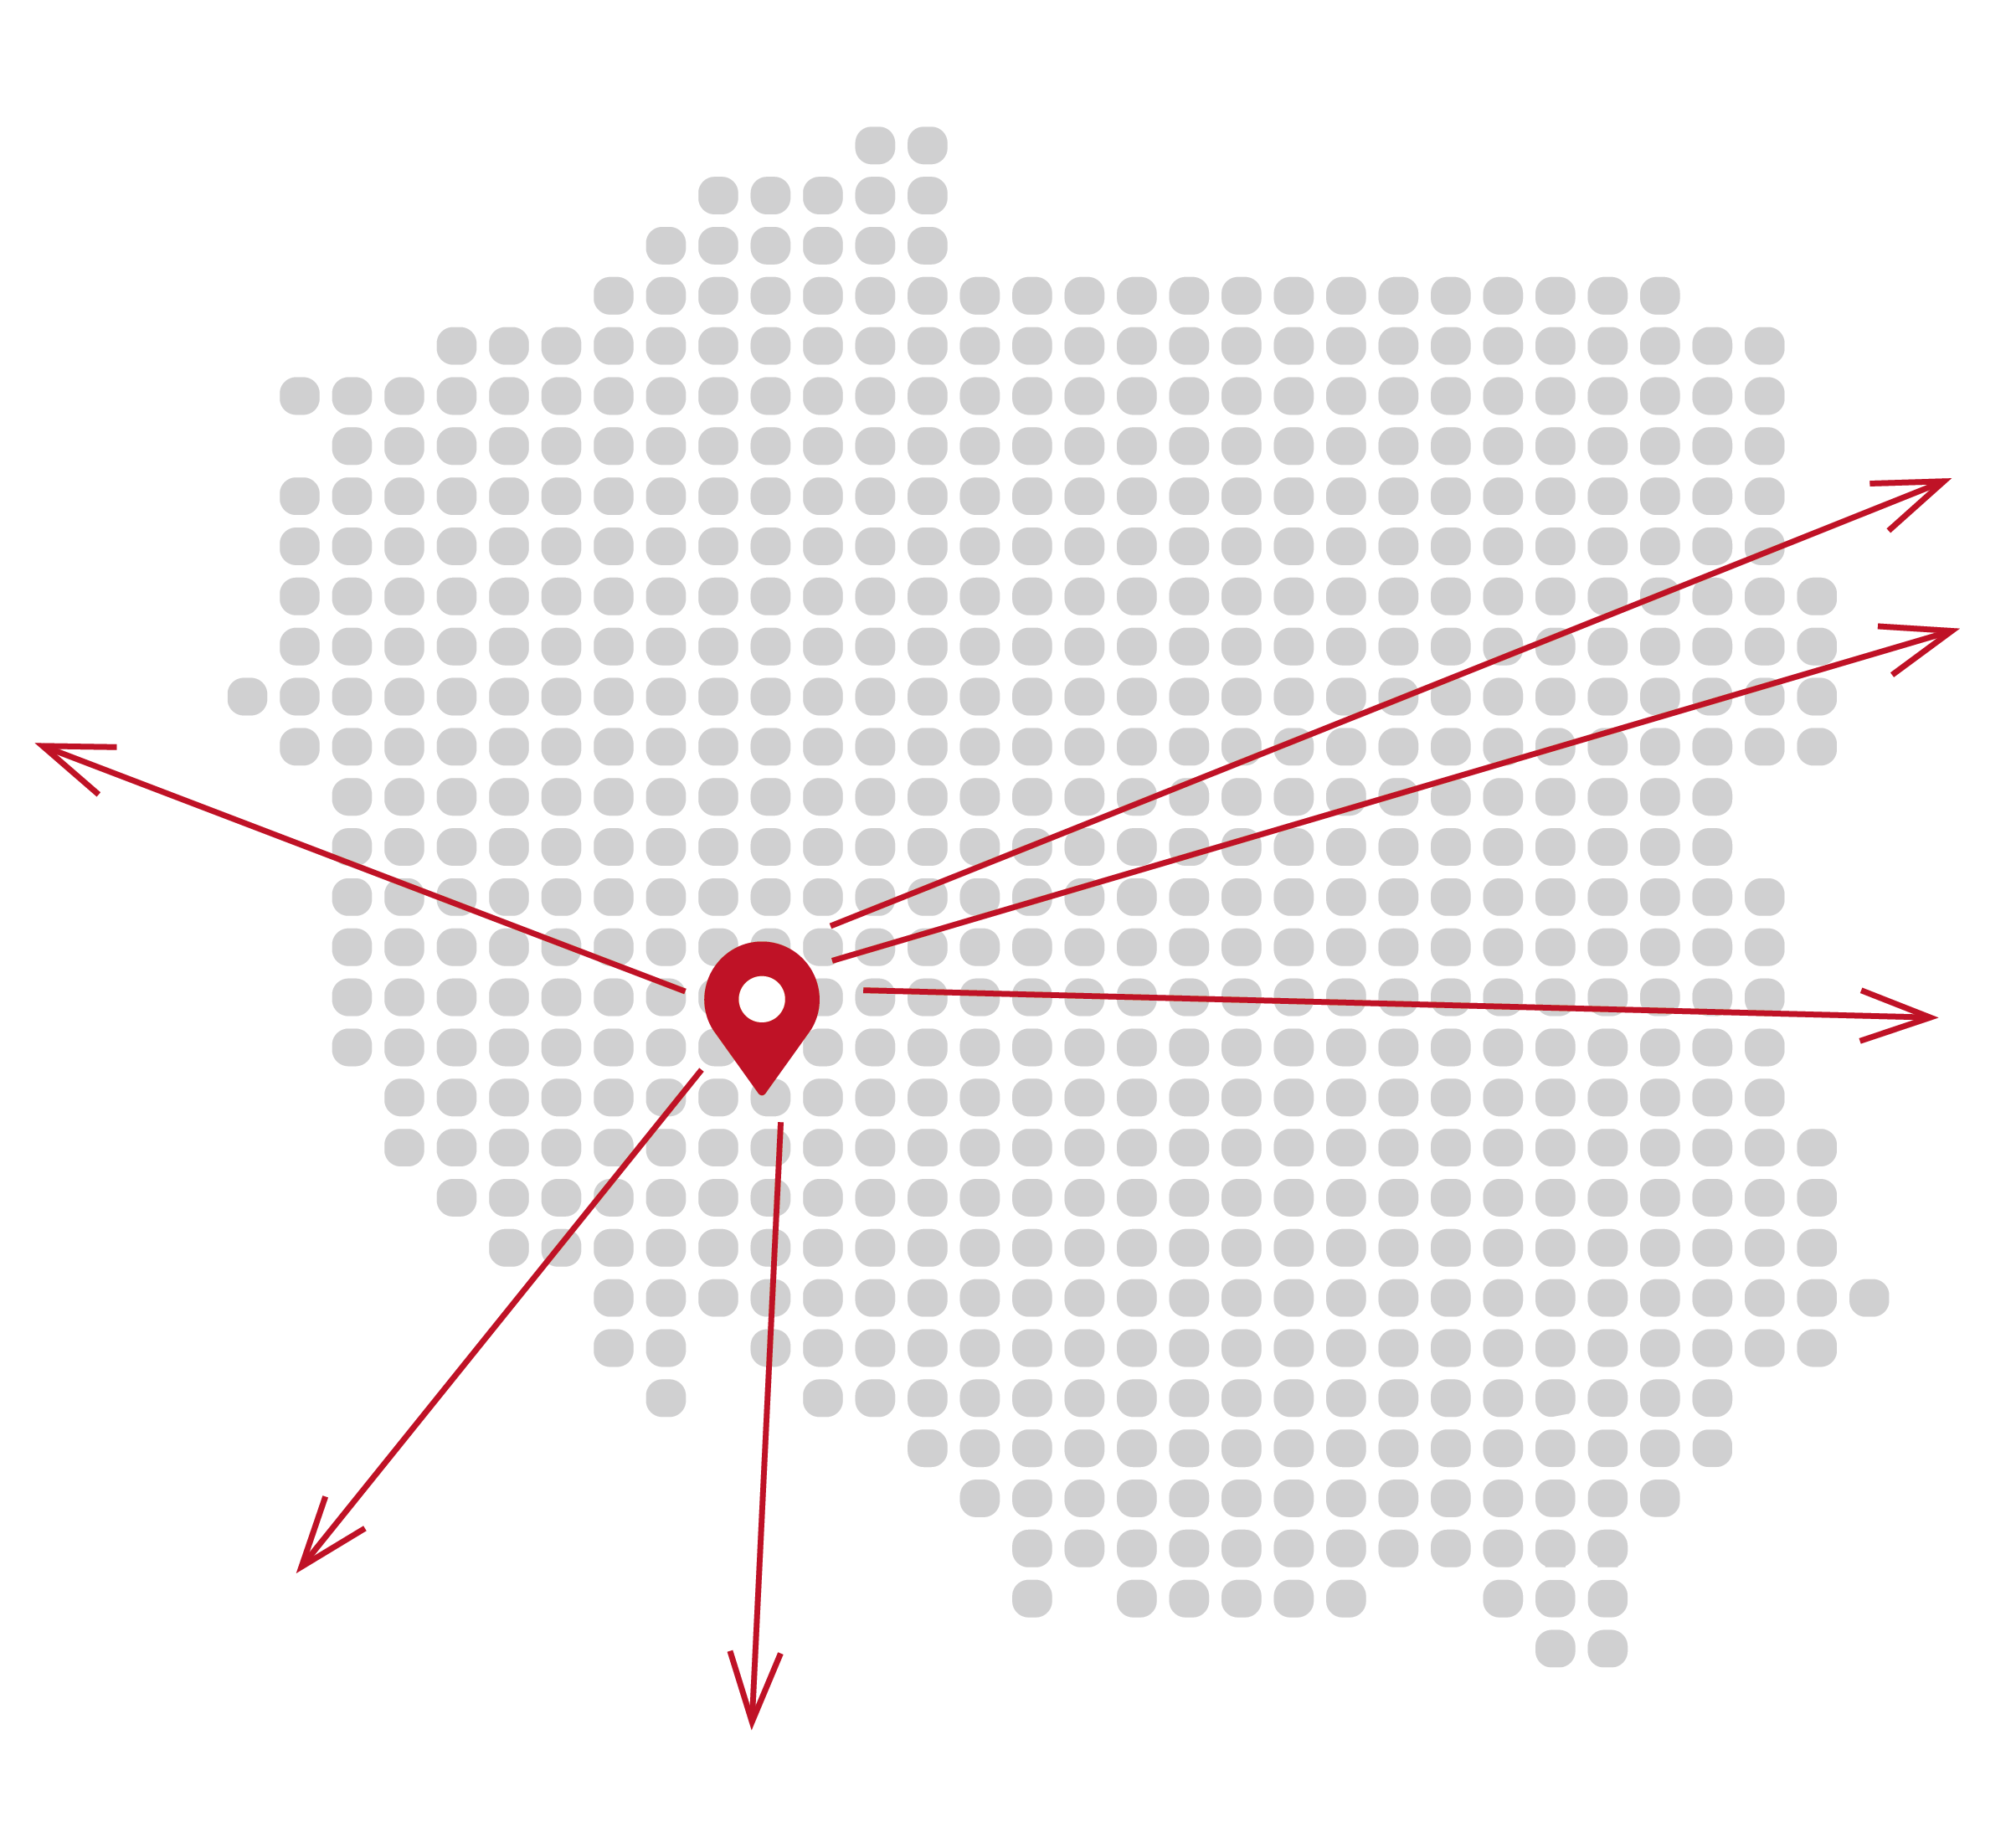
Wrocław
Lower Silesia, one of the most attractive, modern, and prosperous regions of Poland, covers the south-western area of the country, bordering Germany and the Czech Republic.
In 2015, Wrocław was listed among the "Best Cities to Live" in the world ranking of Mercer Consulting and the only Polish city developing as a business centre.
Wrocław was also ranked in the top ten places worth visiting, according to "The Guardian".
Brussels
888 km
Moscow1,594km
Berlin
296 km
Paris
1,079 km
Kiev
1,134 km
Wrocław
Rome
1,081 km
Budapest 427 km
Prague
277km

Slide 3
Wrocław – Poland’s great academic centre
As a city of great academic, cultural, tourist, and economic significance, Wrocław is regarded as one of the most influential centres of education in Poland. Universities and research institutes of the city represent a universally recognized high standard of scientific and educational effort.
Basic facts about Wrocław:
1000-year-old city
12 river islands
112 bridges
29 universities and higher education institutions
120,000 students
population of the agglomeration: approx. 1 million
European Capital of Culture in 2016
World Book Capital in 2016
host of World Games in 2017
Best destination 2018

Slide 4
Popular? Yes, we are
According to the Polish Ministry of Education report, our university has been the most popular university of economics among all the Polish public universities since 2009, in terms of the number of candidates.
Every year we receive over 8,000 entry applications.

Slide 5
Facts and figures
11,500
students of full time and part time courses
500 (214)
foreign students (Erasmus)
87,000
graduates
670
academic staff
4
faculties
10
majors
100
specializations

Slide 6
Four faculties
NE
ZIF
EZIT
IE
Economic Sciences
Management,
Computer Science
and Finance
Economics, Management and Tourism
Engineering and Economics

Slide 7
Undergraduate studies – 9 majors
Business Analytics
Logistics
International Economic Relations
Economics
Tourism
Finance and Accountancy
Management
Management and Production Engineering
Business Informatics

Slide 8
Postgraduate studies – 10 majors
Legal and Economic Consulting
Business Analytics
Economics
Logistics
International Economic Relations
Finance and Accountancy
Spatial Planning
Management
Business Informatics
Management and Production Engineering

Slide 9
Programs in English
Bachelor/Master Study in Finance
Bachelor in Management and Marketing
Bachelor Studies in Business Informatics
Bachelor/Master in Logistics
Bachelor/Master of Business Management
Bachelor/Master Studies in International Business
Executive MBA Program
European Doctoral Program

Slide 10
Other educational projects
Summer School Poland offers students from all over the world a unique opportunity to study economics, visit the unique city of Wrocław and its region, meet new people and have fun – all at the same time. We have already hosted students from all the continents.
The next edition of Summer School Poland will take place 1-15 July 2017. This year, the project is called
Quantitative and Qualitative Methods in Management.
Summer School on Data Science
IT Summer School, organized by the Wroclaw University of Economics in cooperation with the IS:link network, and in close collaboration with the University of Leipzig. This year’s edition of summer school covers an attractive IT/IS subject: Data Science (August, 28th – September, 10th).
The Third Age University helps our elderly alumni to keep up to date with economic, social and everyday issues. And to keep fit as well! 250 seniors have joined the project so far.
Within the the framework of the LifeLongLearning project, we offer a wide range of postgraduate courses and programs intended to enhance our students’ value on the professional market.

Slide 11
International cooperation
International cooperation:
more than 150 bilateral agreements within the framework of the Erasmus Program
over 60 General Cooperation Agreements with foreign partner universities
Member of international institutions:
European University Association
Global Division Santander Universidades
CFA Institute
European Institute for Advanced Studies in Management
AACSB Business Education Alliance

Slide 12
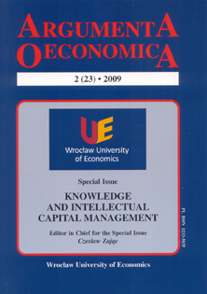
We popularize science
„Argumenta Oeconomica”, published by the Wrocław University of Economics, is listed in the Master Journal List by Thompson Reuters.
The periodical was Poland’s first economic publication among the most prestigious science journals.
To this day, there are only two more Polish publications of that type on this list.

Slide 13
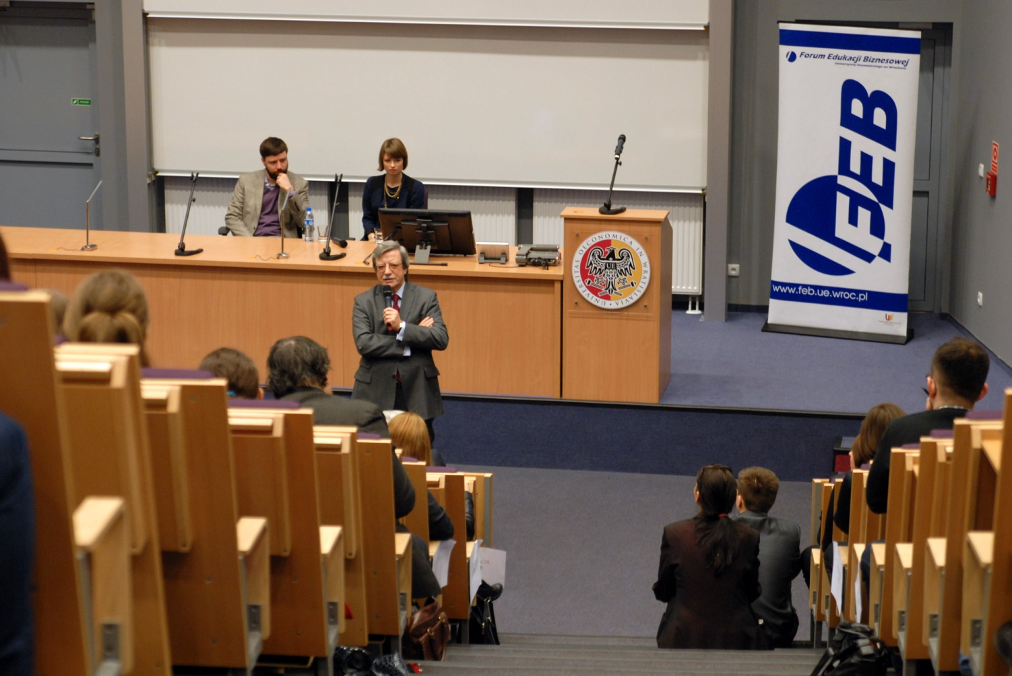
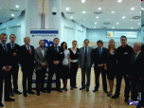
We popularize business
…during the Business Education Forum that lets participants connect economic experience with academic knowledge.

Slide 14
Modern library
Our library has:
300 seats for readers
100 computers
21 cabins for individual work
Our collection includes:
433,000 volumes of printed books and periodicals
online access to 22,000 journals
2,000,000 electronic books
77 databases

Slide 15
Department of Foreign Languages
Overall, the department offers 21 language courses and access to 16 prestigious language certification exams in six languages, with licenses from major international language centres, including the chambers of commerce in Britain, France and Germany, Goethe Institute and Cervantes Institute. The department is licensed to conduct TestDaF examinations and is a certified Cambridge ESOL Exam Preparation Centre.
The Department of Foreign Languages also organizes Chinese and Japanese language courses for students.

Slide 16
Department of Physical Education and Sports
The department offers regular courses of physical education as well as supplementary sports training, recreation, and rehabilitation for students and employees of the University.
At present, we offer courses and training in 20 sports, including aerobics, badminton, basketball, volleyball, handball, football, swimming, athletics, table tennis, unihockey, rock climbing, ballroom dance, tennis, tour cycling, triathlon, horse riding, track and field, skiing, snowboard, and ice skating.

Slide 17
Campus of the Wrocław University of Economics
compact area
in a green part of the city
close to the city centre
perfect for student integration and events
Student accommodation: www.ds.ue.wroc.pl
1,200 beds in two dorms:
„Ślężak” at 33 Ślężna Street
„Przegubowiec” at 35 Kamienna Street

Slide 18
Cooperation with business environment
evaluation, opinions, analyses and advisory services commissioned by business entities
scientific research with practical application
training courses for external organizations
joint apprenticeships, traineeships, courses for graduates/potential employees
cooperation of academic associations with business entities

Slide 19
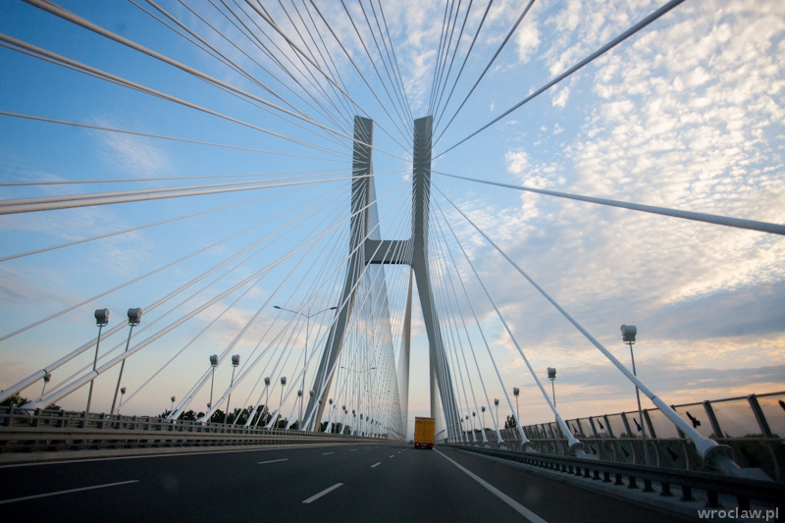
Career services for student & alumni
Career individual & group guidance, career coaching
Internship opportunities & Job offers promotion (on-line platform);
Recruitment processes led by our counselors;
Promotion campaigns support – Career connect;
Skills development trainings & workshops;
Job Fairs each year;
Internship Programmes;
Mentoring Programme;
Employers booklet;

Slide 20
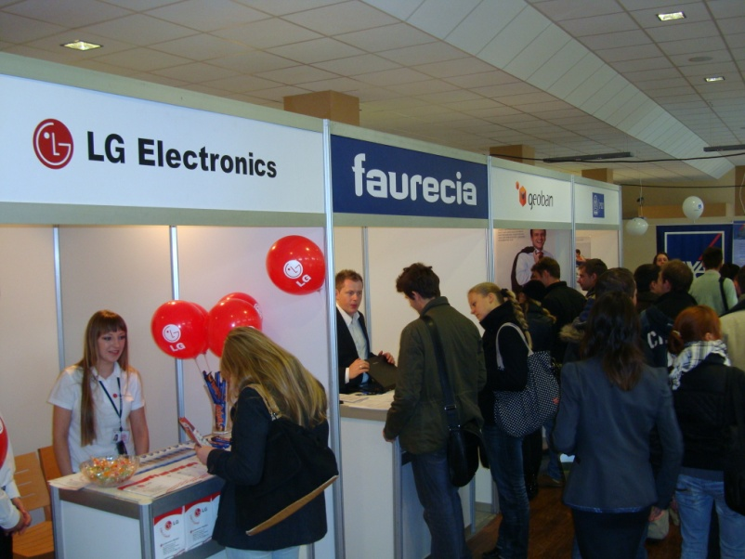
Career Services for employers
Job & internship opportunities placement (on-line platform)
Recruitment processes led by our counselors;
Promotion campaigns support – Career connect;
Skills development trainings & WorkShops
Job Fairs
EU-funded Internship Programmes
Employers booklet

Slide 21
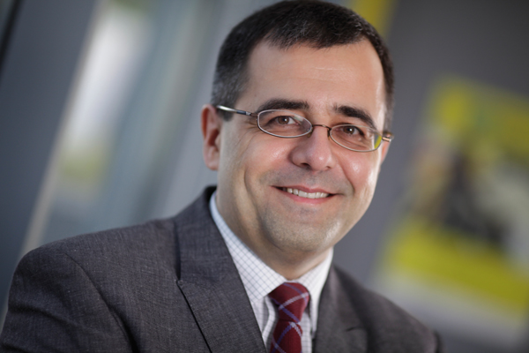
Our alumni: What business high-fliers say about our university
Krzysztof Andrulewicz – former CEO of Skanska SA:
For me, the Wrocław University of Economics is two basic values: the people I met – unconventional and really great, and the knowledge – something I wouldn’t have got if I hadn’t studied there. Highly recommended!
Agnieszka Orłowska - Director EMEA Customer Experience (CEE) and Head of Wroclaw Site at Google
The University of Economics offers more than a theoretical, broad basis in various fields of science. It mainly gives you experience and contacts with business practitioners while you are still a student.

Slide 22
Our alumni on the labour market
91% of MA graduates find employment
76% find a job within 3 months from graduation
75% employed in fields directly related to their majors
85% satisfied with current employment

Slide 23
Accreditations

Slide 24
Our mascot
Our mascot
Thank you for your attention

