Slide 1




Practically - the best!
ue.wroc.pl

Slide 2
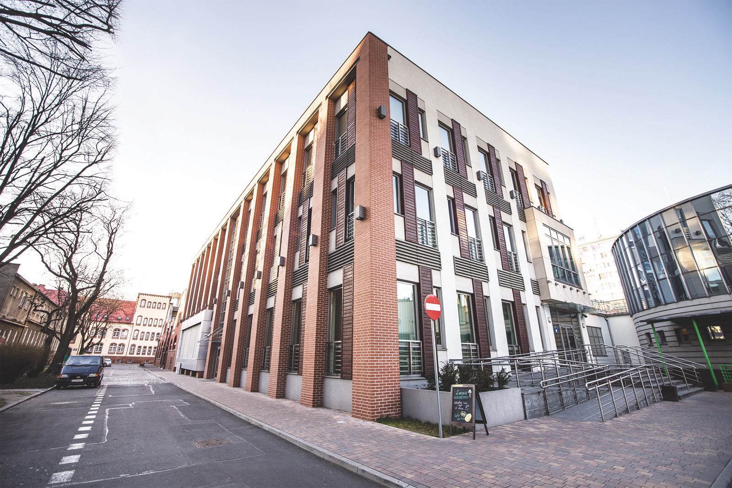

Why Wroclaw University of Economics and Business?

Slide 3
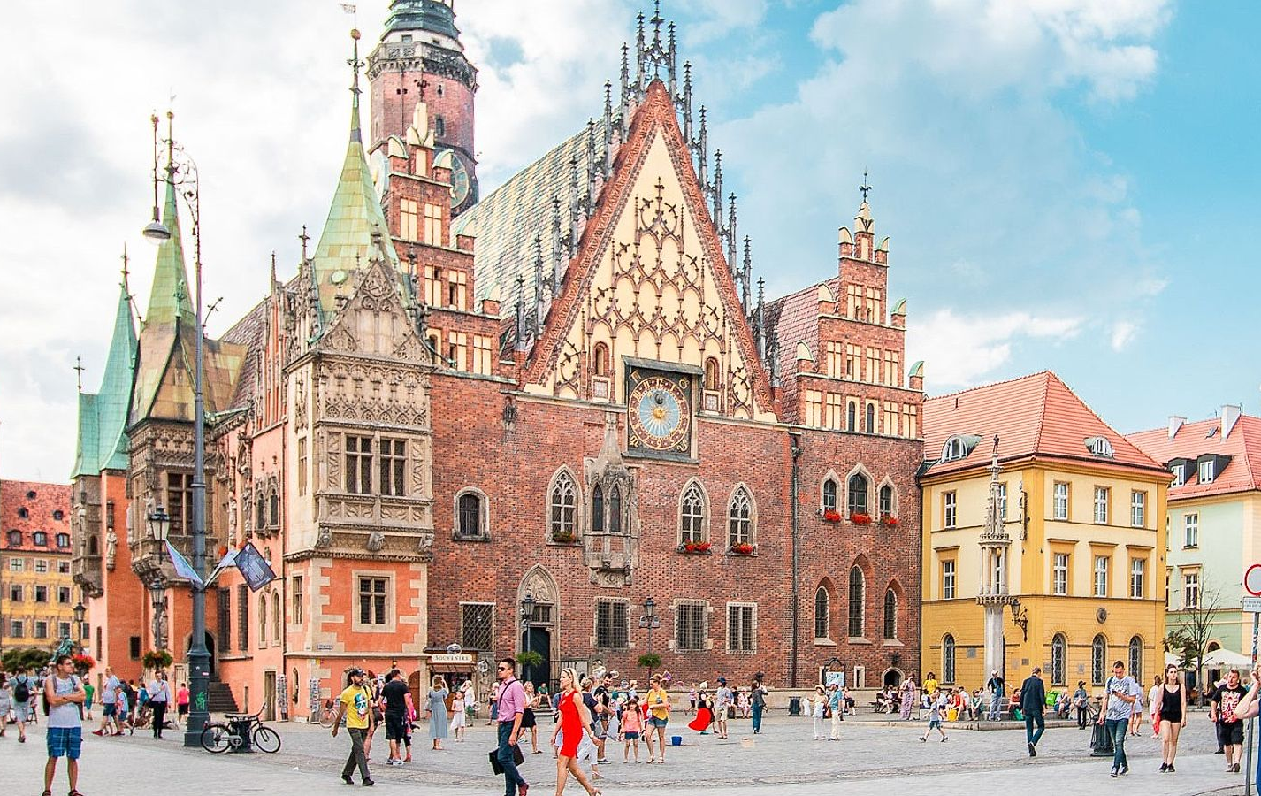
Wrocław
Basic facts about Wrocław:
Population: 634 thousand
Population of agglomeration: approx. 1 million
Within driving distance to Prague, Berlin, Vienna and Warsaw
1000-year-old city
12 verdant islands
112 bridges
Wrocław has been selected as a European Capital of Culture in 2016.

Slide 4

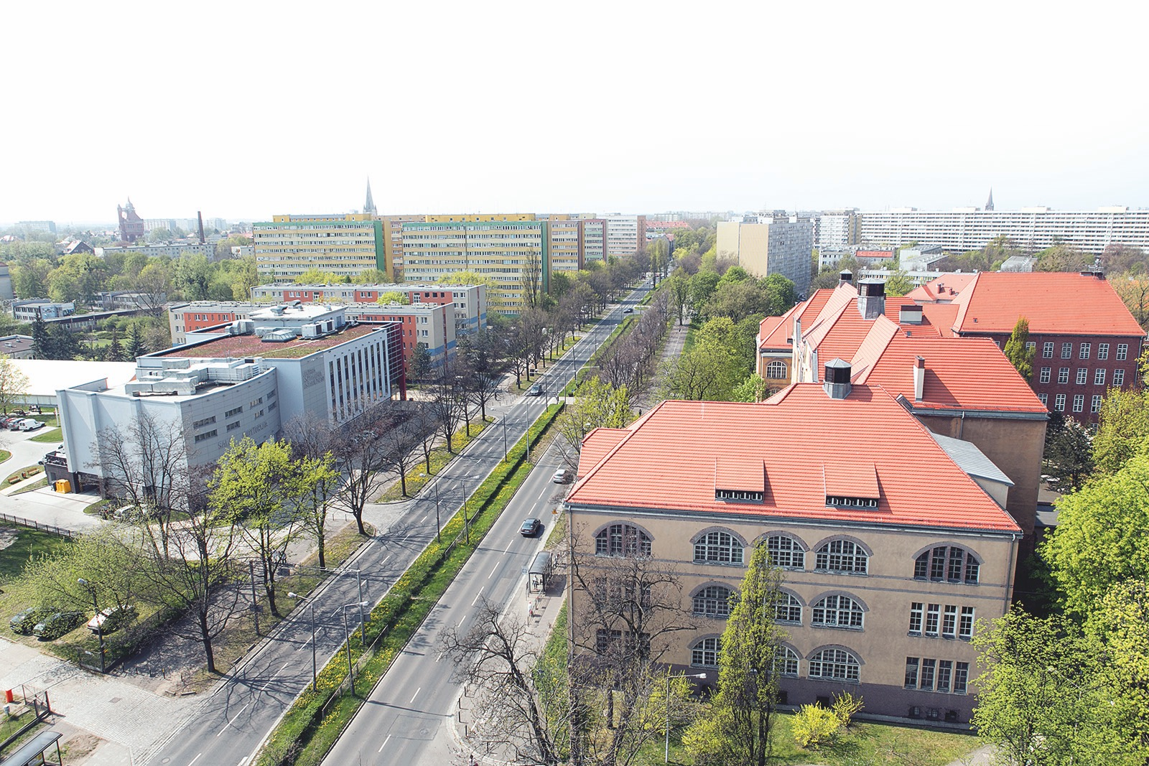
Campus of the WUEB
in the green district of the city,
close to the center,
promotes the integration of the academic community,
Accommodation:
Wroclaw University of Economics provides accommodation for all students in the University's dormitories.
Rooms for exchange students are reserved in two dormitories: "Slezak" and "Przegubowiec".

Slide 5
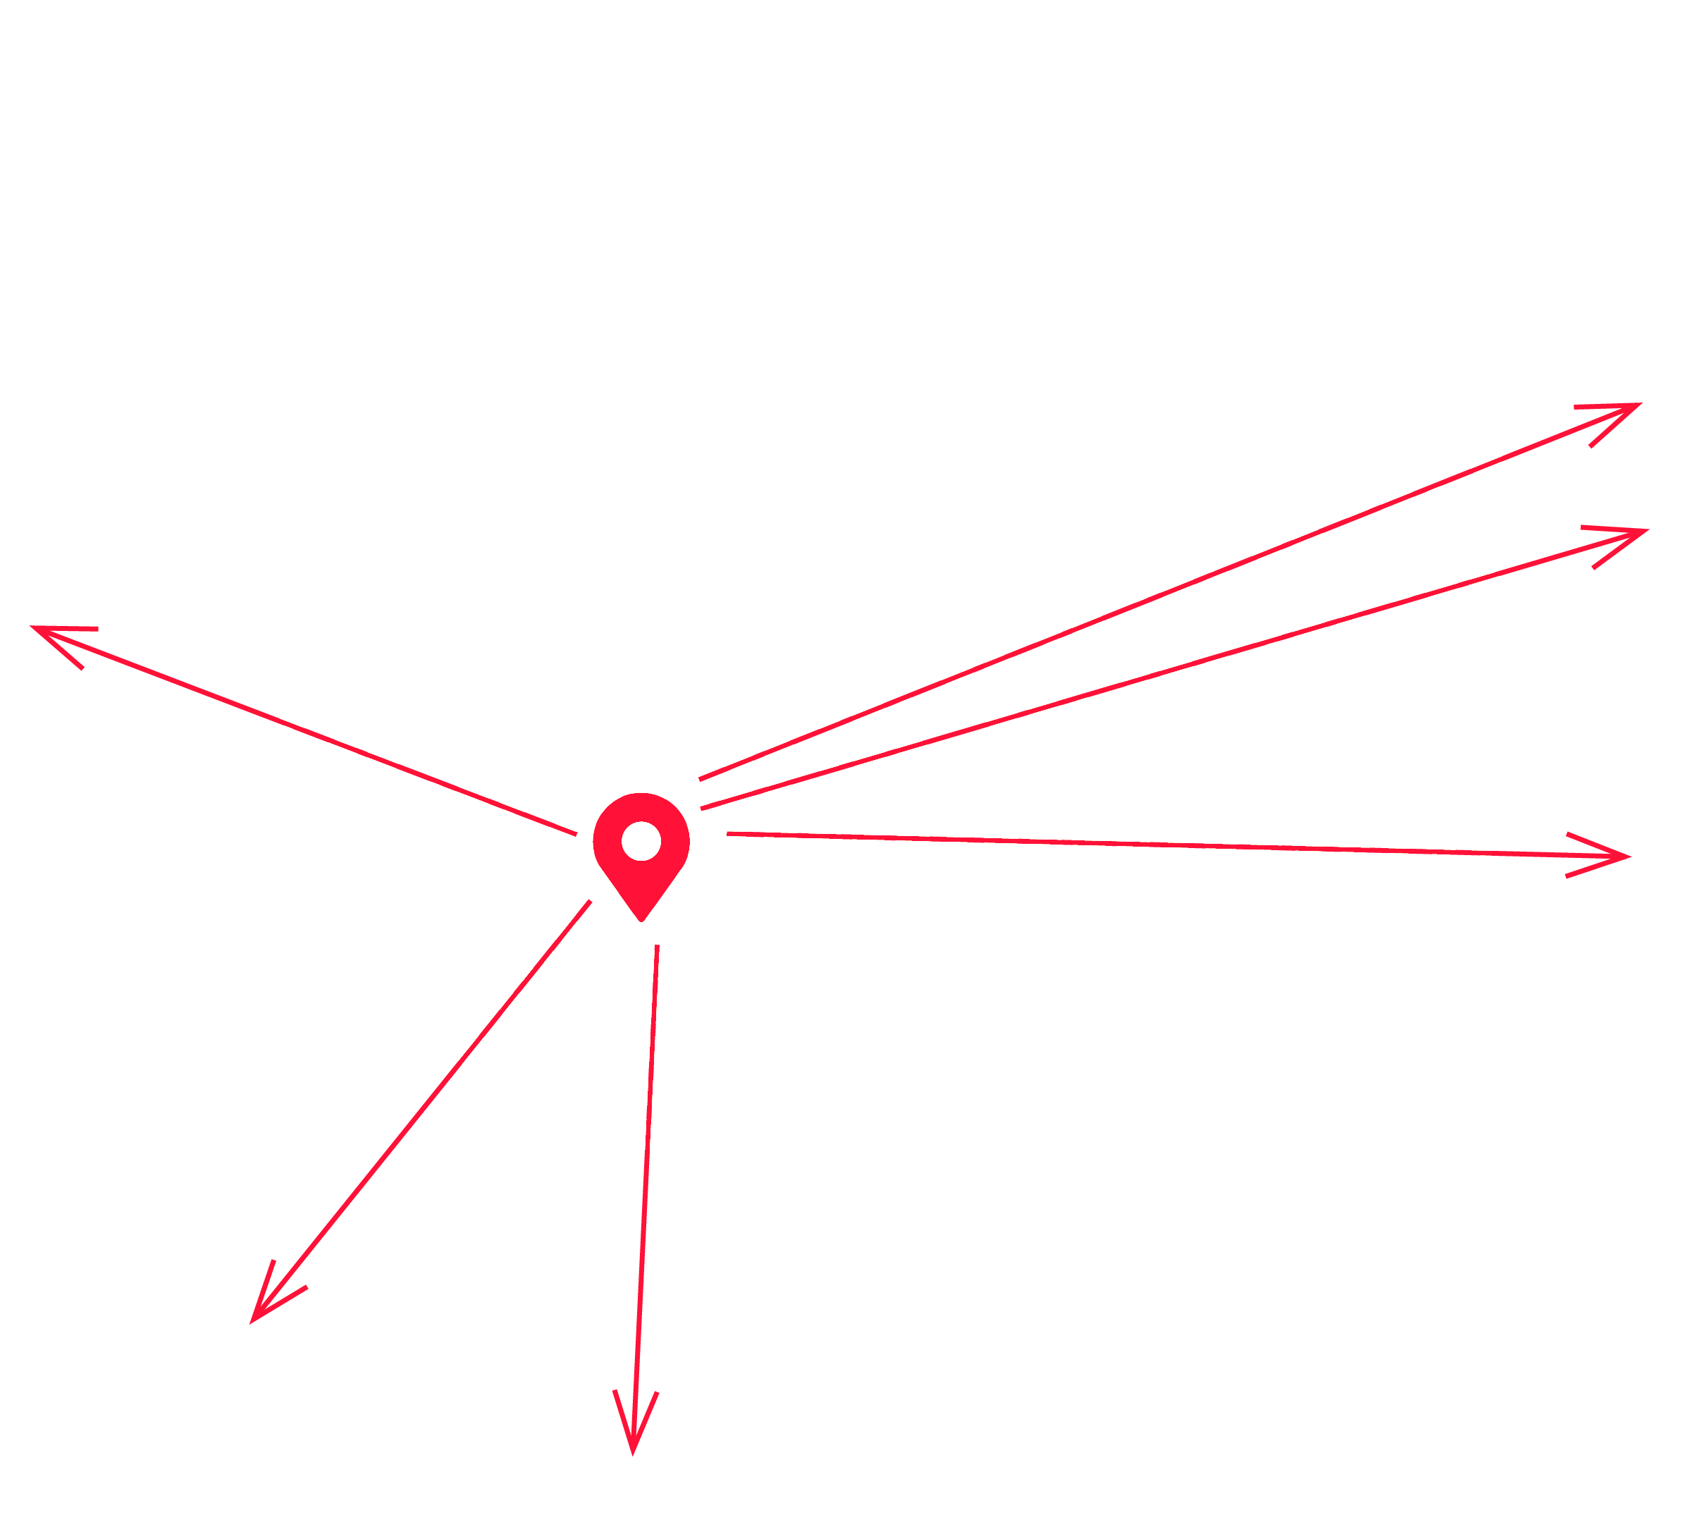

Campus of the WUEB
Brussels
888 km
Moscow1,594km
Berlin
296 km
Location: Lower Silesia
Lower Silesia, one of the most attractive, modern, and prosperous regions of Poland, covers the south-western area of the country bordering Germany and the Czech Republic.
Paris
1,079 km
Kiev
1,134 km
Rome
1,081 km
Prague
277km
Budapest
427 km

Slide 6


The Physical Education and Sports Department
A modern sports base including:
rooms for team games and aerobics, climbing wall, gym, rehabilitation room, swimming pool, sauna and many others.

Slide 7
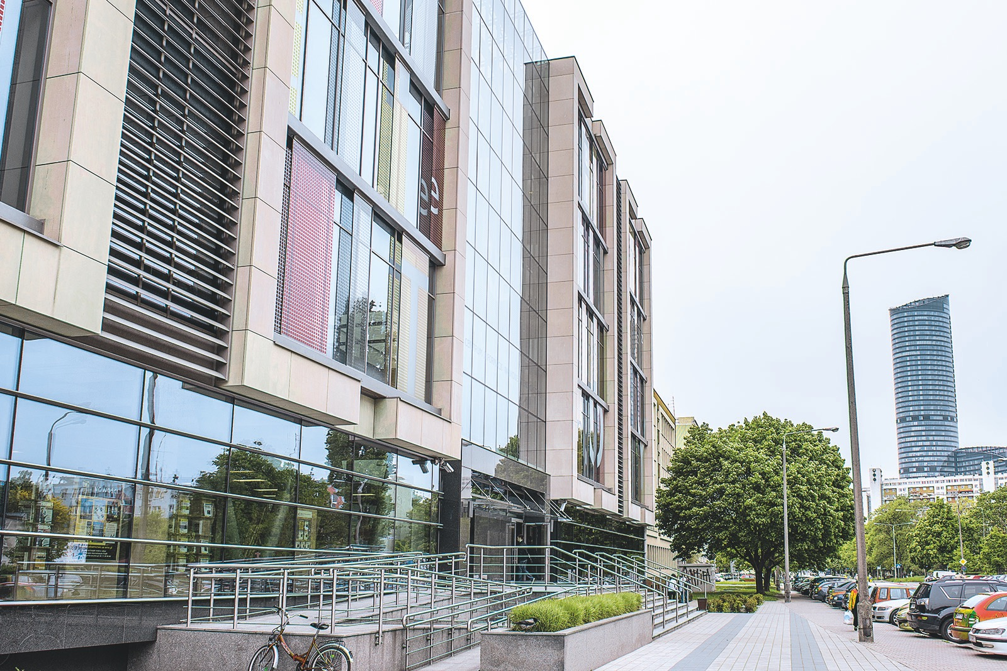

Main Library
Our Library has:
two conference rooms, two seminar rooms,
15 kilometers of shelves in bookcases,
300 seats for readers,
100 computers,
21 cabins for individual work.
Our Collections:
433,000 volumes of printed books and periodicals,
14,300 journals in online access,
2,630,000 electronic books,
67 databases.

Slide 8


Department of Foreign Languages
Overall, the department offers 21 language courses and access to 16 prestigious language certification exams in six languages, with licenses from major international language centres, including the chambers of commerce in Britain, France and Germany, Goethe Institute and Cervantes Institute. The department is licensed to conduct TestDaF examinations and is a certified Cambridge ESOL Exam Preparation Centre.
The Department of Foreign Languages also organizes Chinese and Japanese language courses for students.

Slide 9
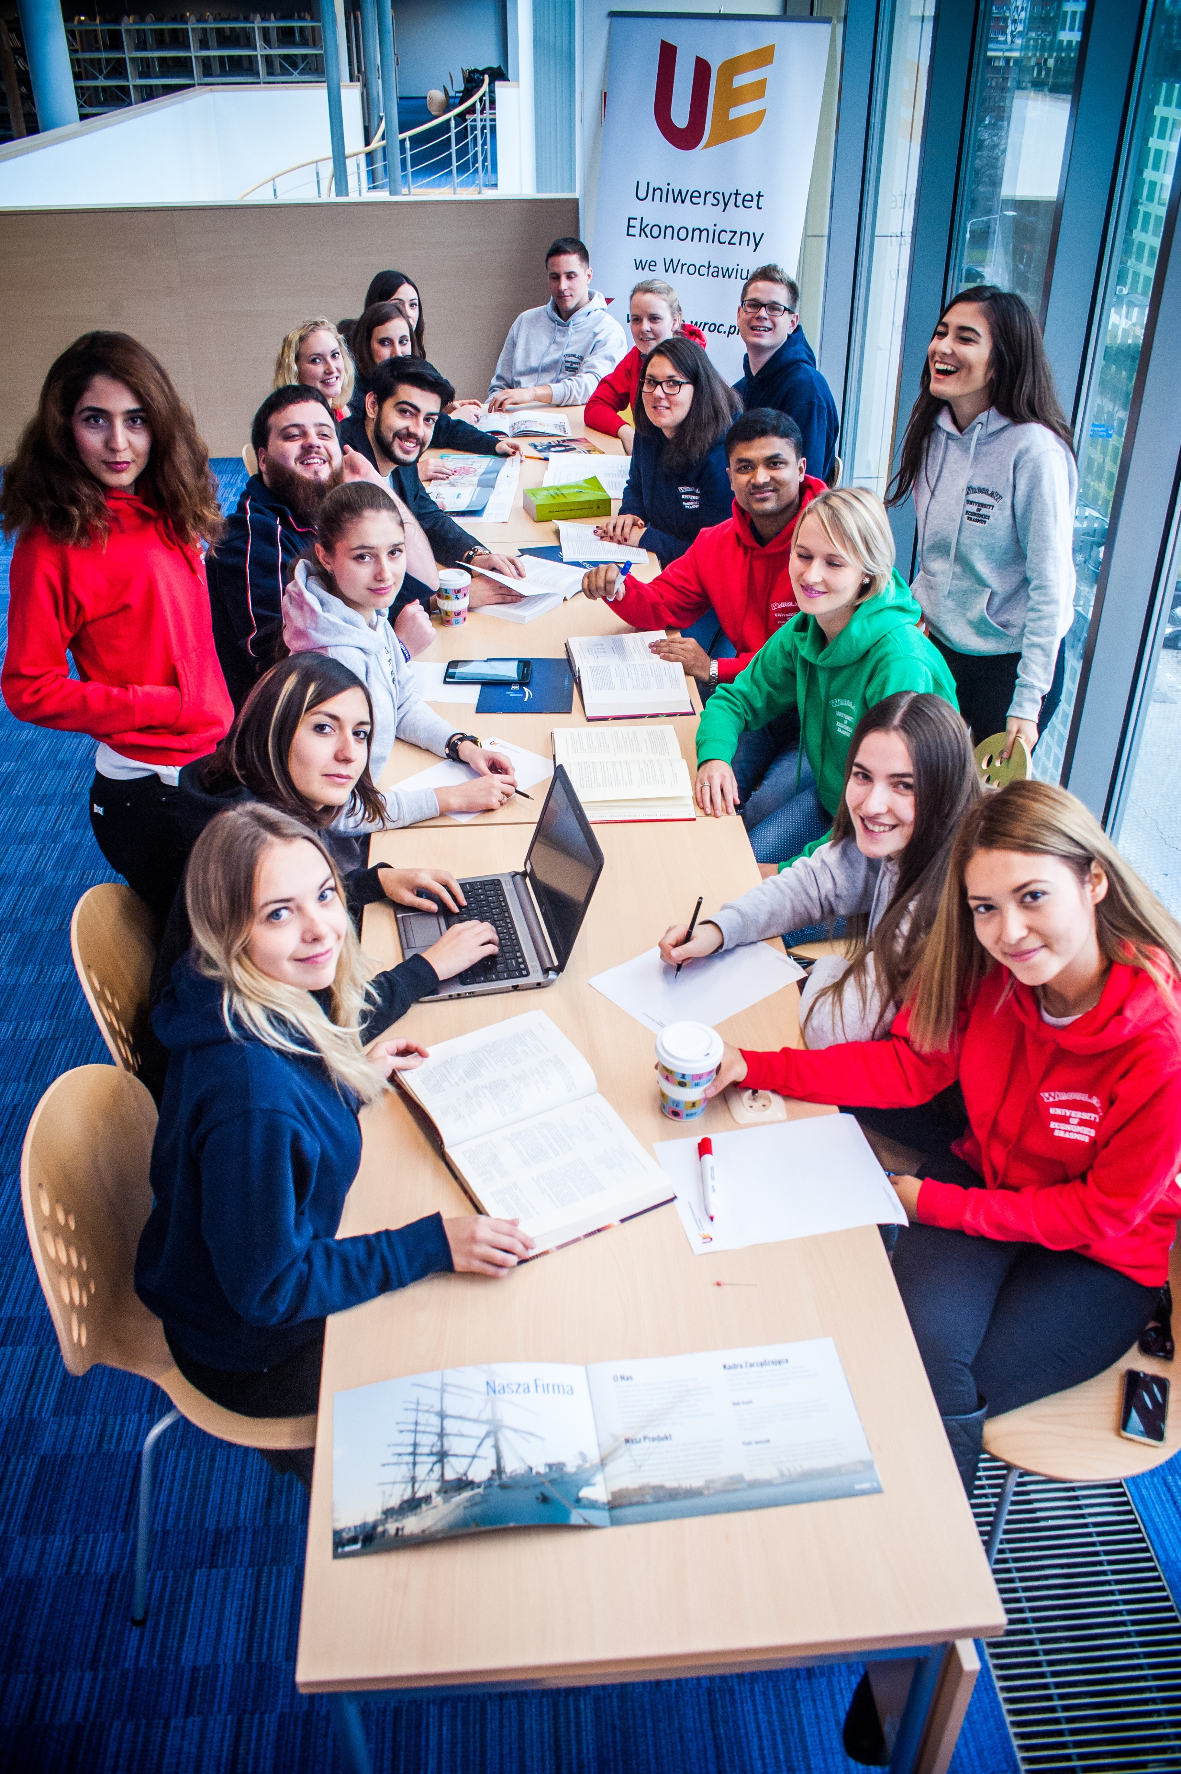

International cooperation
International cooperation:
more than 150 bilateral agreements within the framework of the Erasmus Program
over 60 General Cooperation Agreements with foreign partner universities
Member of international institutions:
AACSB
EUA
CEEMAN
EDAMBA
Santander Universities
PRME
EIT +
CFA Institute

Slide 10
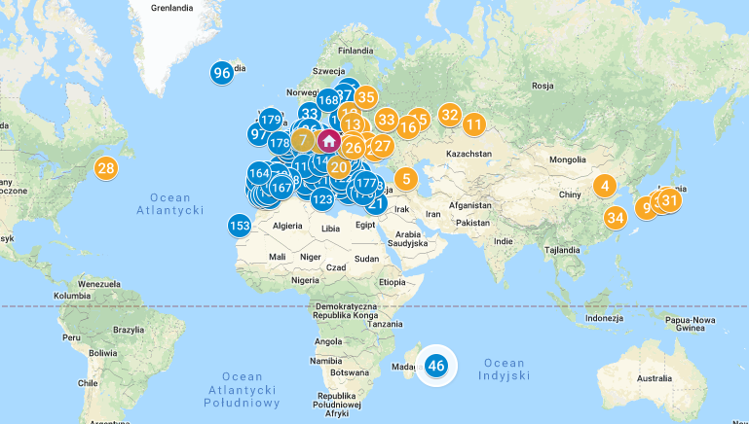
International cooperation

Slide 11
Cooperation with business
The Entrepreneurship Incubator inQUBE
The mission core of the inQUBE is to be
a significant centre of creative and innovative thought, a place where innovative businesses start, develop and flourish.
244 m2 of co-working space,
approx. 400 m2 of office space on the first and second floor of the building.

Slide 12


Recruitment Information

Slide 13





Bachelor Degree in Polish
Economic Analytics
International Economic Relations
Economics
Accounting and Controlling
Business Economics
and Finance
Management
Finance and Accounting
Production Management and Engineering
Information Technology
in Business
Management
in the Modern Economy
Logistics

Slide 14

Bachelor Studies
Bachelor of Business Management
Bachelor Studies
in Finance
Bachelor Studies
in Business Informatics
Bachelor Studies in International Business

Slide 15

Master Studies
Master Studies in Finance
Master of Business Management
Program of Master in International Business
Executive MBA Program

Slide 16
PhD Studies
European Doctoral Program in Economics, Management and Finance

Slide 17

Join us on Facebook and Instagram!
#UEwroc

